Slide 1
Computing the Shapley Value of Facts in Query Answering
Daniel Deutch, Tel Aviv University, Israel
Workshop on Factorized Databases,
Zurich, August 4, 2022

Slide 2
European Research Council Project ProDIS: Provenance for Data Intensive Systems
Explanations for Data-Intensive Systems
Expressiveness
Scale
Understandability
Data Provenance: models and algorithms

Slide 3
The talk is largely based on:
Daniel Deutch, Nave Frost, Benny Kimelfeld, Mikaël Monet: Computing the Shapley Value of Facts in Query Answering. SIGMOD Conference 2022: 1570-1583
System Demonsrations:
Susan B. Davidson, Daniel Deutch, Nave Frost, Benny Kimelfeld, Omer Koren, Mikaël Monet: ShapGraph: An Holistic View of Explanations through Provenance Graphs and Shapley Values SIGMOD Conference 2022: 2373-2376
Dana Arad, Nave Frost, Daniel Deutch: LearnShapley: Learning to Predict Rankings of Facts Contribution Based on Query Logs, Demo@CIKM 2022 (to appear).

Slide 4
Explaining Computation
Machines may soon rule our lives (to the extent that they do not already..)
And their decision-making is just getting more and more opaque
We need justifications/explanations
For accountability, to identify biases, for debugging…
Multiple notions of explanations have been proposed, and some are already widely used in industry in the context of ML (Shapley, Counterfactuals)
Explanations for DB cleaning/query/analysis could (should?) help

Slide 5
Data Provenance
“Return customers with overdraft events after 2006”
eventid | sum | type | due | Prov
1 | 50000 | overdraft | 2012 | p1
2 | 400000 | mortgage | 2014 | p2
3 | 2000000 | overdraft | 2010 | p3
custname | eventid | prov
Smith | 1 | c1
Smith | 3 | c2
Roth | 2 | c3
custname | prov
Smith | p1·c1+p3·c2

Slide 6
SELECT Customer.cname FROM Customer, Ownership, Product, Assoc, Event, DebtEvent, Currency
WHERE Customer.cid = Ownership.cid and Ownership.pid = Product.pid and Product.type LIKE '%account' and Product.pid=Assoc.pid and
Assoc.eid=Event.eid and
Event.date > '01.01.2007' and Event.eid = DebtEvent.eid AND DebtEvent.sum > 2000 AND DebtEvent.cid = Currency.cid AND Currency.symbols LIKE '%€%'
…
“Return owners of accounts with overdraft events exceeding a sum of €2000
after the year 2006”

Slide 7
cname | prov
Smith | CO123·O1325·P85335·A8214·E23874·DE23874·CU2+ CO123·O1325·P85335·A4326·E9873·DE9873·CU2+ …
Jones | C8432·O12387·P1248·A9238·E2384·DE2384·CU2+ …
…
“Return owners of accounts with overdraft events exceeding a sum of €2000
after the year 2006”

Slide 8
Fine-grained (“how”) provenance
Well-founded for quite expressive query languages (SPJU with extensions to agg+diff+..)
PTIME computable
Captures the “essence of computation” ([set-equivalent] queries yield equivalent [Boolean] provenance)
Semiring provenance [GKT ‘07]: Commutation with homomorphism allows to specialize in multiple meta-data structures of interest
On the other hand:
Difficult to understand by end-users (We will mostly focus on this issue)
Costly (space+time) in practice (We will briefly discuss this issue)

Slide 9
Alternatives
Note that how-provenance details how different tuples “work together” in query evaluation
Joint vs. alternative use
Alternatives that may be clearer to the end-user:
Lineage [Cui Widom Wiener, TODS ’00] is the set of contributing facts
Quantifying/ranking the contribution:
Causality, Responsibility, Counterfactuals [Meliou, Gatterbauer, Moore and Suciu, VLDB ‘10], [Freire, Gatterbauer, Immerman and Meliou, VLDB ‘15],…
Shapely values [Livshits, Bertossi, Kimelfeld and Sebag, ICDT ’20], [Reshef, Kimelfeld and Livshits, PODS ‘20],…

Slide 10
Shapley values
Shapley value is a notion from cooperative game theory
A way to fairly distribute “wealth”/contribution among a set of players
Let $N$ be a finite set of players and let $v:2^{N}→ℝ$ be a “game value” function for sets of players. For each player $a$:
$Shapley\left(N,v,a\right)=\sum_{S⊆N∖\left\{a\right\}}{\frac{\left|S\right|!\left(\left|N\right|−\left|S\right|−1\right)!}{\left|N\right|!}\left(v\left(S∪\left\{a\right\}\right)−v\left(S\right)\right)}$

Slide 11
Properties of Shapley
Efficiency: the sum of Shapley values over all players equals $v\left(N\right)$
Equal treatment of equals (symmetry): for each two players i,j such that for every set S that includes neither i nor j we have $v\left(S∪\left\{i\right\}\right)=v\left(S∪\left\{j\right\}\right),$it holds that i and j have equal Shapley values.
Linearity w.r.t. the game value function
Null values: if a player does not contribute to any set, they get a Shapley value of 0

Slide 12
SHAP
Feature attribution in ML
We are given an instance and a model and wish to assign a contribution score to each feature of the model
…via Shapley values
For simplicity, we will discuss Boolean classifiers but SHAP is general-purpose
For a subset S of features, the game value function $v\left(S\right)$ is the expected model outcome conditioned on the instances agreeing with $S$
Expected: with respect to a probability distribution over the instances
Lundberg and Lee, A Unified Approach to Interpreting Model Predictions, NeurIPS 2017

Slide 13
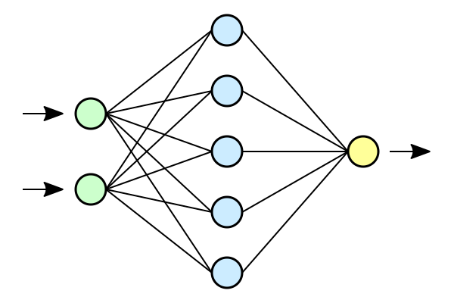
SHAP
Lundberg and Lee, A Unified Approach to Interpreting Model Predictions, NeurIPS 2017
Feature #13 (“Interest in Fashion”)
Feature #68 (“Likes patterns”)
…
Notes:
Probably the most popular approach for black-box model explanations is SHAP.
This is a feature attribution approach, that is based on the notion of Shapley values, that determine an importance score to each of the input features.
In this case, we can see that the most influential features are the user interest in Fashion items, and the fact the they like patterns.

Slide 14
SHAP
Lundberg and Lee, A Unified Approach to Interpreting Model Predictions, NeurIPS 2017
But what are these features based on?
Feature #13 (“Interest in Fashion”)
Feature #68 (“Likes patterns”)
…

Slide 15
“Interest in Fashion” Feature
A user is interested in fashion if they have:
Previously purchased items from the “Fashion” category
Previously purchased an item which was also purchased by a buyer who previously purchased an item from the “Fashion” category
Searched for at least two queries related to the “Fashion” category
Notes:
To continue our search for the root-cause of the recommendation we need to go one step deeper.
We need to open the model pipeline, and check what is the logic of the “interest in Fashion” feature.
Here we see that the feature logic is based on a union of three conjunctive queries.
According to the pipeline logic – a user would be interested in fashion, if any of the following conditions holds true:
The user purchased items from the “Fashion” category
The user purchased an item which was also purchased by a buyer who previously purchased an item from the “Fashion” category
The user searched for at least two queries related to the “Fashion” category

Slide 16
Notes:
According to the query logic we see four users that are interested in Fashion items.
Now, recall that Alice wants to know what information influenced her recommendations for patterned shoes.
According to the query, and using the notion of Shapley values – which we will soon discusses – we can quantify the importance of each record in the database to the outcome that Alice is interested in Fashion items.
We can see that the most influential records is the fact that Alice has previously purchased a Gucci Soho hand-bag, which is a Fashion item.
Another influential facts (but with lesser importance) are the a_1, a_3, and a_4 facts as both Alice and Bob bought an iPhone item, and bob also bought an item from the Fashion category.
This ranking of records can explain the main reasons for Alice’s recommendations.

Slide 17
Shapley value in query answering
Given a database $D$ and a Boolean query $q$, let $f∈D$ be a fact, the Shapley value of $f$ in $D$ for query $q$ is defined as
$Shapley\left(q,D,f\right)=\sum_{E⊆D∖\left\{f\right\}}{\frac{\left|E\right|!\left(\left|D\right|−\left|E\right|−1\right)!}{\left|D\right|!}\left(q\left(E∪\left\{f\right\}\right)−q\left(E\right)\right)}$
This definition applies beyond Boolean queries, e.g. aggregates
A variant for exogenous and endogenous facts
Livshits et. al., The Shapley value of tuples in query answering, ICDT 2020
Notes:
[explain the brackets for Boolean queries]

Slide 18
Prior Research on Shapley and SHAP in Query Answering
Two main lines of recent research work:
Lifshitz, Bertossi, Kimelfeld, Sebag and Reshef introduced the problem and provided dichotomy results for its complexity for multiple query languages
Arenas, Barcelo, Bertossi and Monet provided tractability results for SHAP scores (rather than Shapley) via knowledge compilation
Knowledge Compilation (see [Darwiche and Marquis, JAIR ‘02]) focuses on offline compilation of Boolean function spec. in a structure favorable for online queries
It has met database theory thanks to [Jha and Suciu, ICDT ‘11], with many applications
Here we use knowledge compilation to achieve efficient algorithms for Shapley
Introduce heuristics for cases where compilation fails/ is too costly
And for the first time, implement and make it work in practice

Slide 19
Some previous theoretical results
Any Boolean query Q induces a problem Shapley(Q) with input D, f
A dichotomy for the class of self-join-free Boolean CQs:
For non-hierarchical queries, the problem of computing $Shapley(D,q,f)$ for a given database $D$and a fact $f$ is $FP^{\#P}$- $complete$
For hierarchical queries, the problem is in PTIME
FPRAS based on Monte-Carlo Sampling
Inefficient in practice
Livshits et. al., The Shapley value of tuples in query answering, ICDT 2020
Notes:
Add the result for heirarchical queries

Slide 20
Our solution (A Bird’s Eye View)
Exact computation
Knowledge compilation
Exact algorithm
Shapley values
Database $D$
Query $q$
Provenance circuit $c$
ProvSQL
Inexact computation
Proxy func.
Inexact algorithm
Influence ranking
Notes:
In this work, we developed and optimized practical solutions for computing Shapley values in query answering.
We first show that exact computation of Shapley value is feasible in cases that the query provenance can be transformed to a circuit with desirable properties.
Namely, Shapley values can be computed efficiently in case the provenance can be compiled to a deterministic and decomposable circuit.
This result extend the exact tractable cases to more queries than those identified by Livshits et. al.
For the harder cases, where knowledge compilation of the provenance is infeasible, we propose an inexact heuristic approach.
The inexact approach generates a proxy function that is also based on the query provenance, and uses it to assign an influence score to the database facts. Even though the results of the inexact approach are different than the real Shapley values, the ranking of influential facts tends to the same as the ranking based on Shapley values.
Next, we will start with the exact computation approach.

Slide 21
Exact computation

Slide 22
Knowledge Compilers and d-D Circuits
Knowledge Compilers convert a given Boolean circuit to a “favorable” form.
Here we use d-D: deterministic and decomposable circuits.
For a gate $g$, we write $vars(g)$ to denote the set of variables that have a directed path to $g$
An $∧$-gate $g$ is decomposable if for every two input gates $g_{1}≠g_{2}$ we have $vars\left(g_{1}\right)∩vars\left(g_{2}\right)=∅$
We call a circuit $C$ decomposable if all $∧$-gates in it are decomposable
An $∨$-gate $g$ is deterministic if for every two input gates $g_{1}≠g_{2}$there is no assignment that satisfies both
We call a circuit $C$ deterministic if all $∨$-gates in it are deterministic
Notes:
An and-gate is called decomposable if for every two of its input gates the intersection of their variable is empty.
And a circuit will be called decomposable – if all of its and-gates are decomposable.
An or-gate called deterministic if for every two input gates there is no assignment that satisfies them both.
And again, a circuit is called deterministic - if all of its or-gates are deterministic.

Slide 23
Example

Slide 24
Reduction to $\#SAT_{k}$
$\#SAT_{k}$ problem definition
Given a Boolean circuit $φ:2^{X}→\{0,1\}$
$SAT\left(φ\right)⊆2^{X}$ the set of all satisfying assignments of $φ$
$SAT_{k}\left(φ\right)=SAT\left(φ\right)∩\left\{ν∈X∣\left|ν\right|=k \right\}$
$\#SAT_{k}(φ)=\left|SAT_{k}\left(φ\right)\right|$
$\#SAT_{k}(φ)$ is the number of assignments of size $k$ that satisfy $φ$
Notes:
So, as I said $\#SAT_{k}(φ)$ is how many assignments of size $k$ satisfies $φ$

Slide 25
Reduction to $\#SAT_{k}$
$$Shapley\left(D,q,f\right)=\sum_{S⊆D∖\left\{f\right\}}{\frac{\left|S\right|!\left(\left|D\right|−\left|S\right|−1\right)!}{\left|D\right|!}\left(q\left(S∪\left\{f\right\}\right)−q\left(S\right)\right)}$$
Notes:
Now, lets get back to the computation of Shapley values

Slide 26
Reduction to $\#SAT_{k}$
$$Shapley\left(D,q,f\right)=\sum_{S⊆D∖\left\{f\right\}}{\frac{\left|S\right|!\left(\left|D\right|−\left|S\right|−1\right)!}{\left|D\right|!}\left(q\left(S∪\left\{f\right\}\right)−q\left(S\right)\right)}$$
Let $C$ be a circuit equivalent to the provenance of $q$ over $D$.
Notes:
And let $C$ be a circuit equivalent to the provenance of $q$ over $D$.

Slide 27
Reduction to $\#SAT_{k}$
$$Shapley\left(D,q,f\right)=\sum_{S⊆D∖\left\{f\right\}}{\frac{\left|S\right|!\left(\left|D\right|−\left|S\right|−1\right)!}{\left|D\right|!}\left(q\left(S∪\left\{f\right\}\right)−q\left(S\right)\right)}$$
Let $C$ be a circuit equivalent to the provenance of $q$ over $D$. Let $C_{f=0}$ and $C_{f=1}$ be the circuits obtained from $C$ by replacing $f$ gates with 0 and 1 respectively.
Notes:
We will denote by $C_{f=0}$ and $C_{f=1}$ be the circuits obtained from $C$ by replacing $f$ gates with 0 and 1 respectively.

Slide 28
Reduction to $\#SAT_{k}$
$$Shapley\left(D,q,f\right)=\sum_{S⊆D∖\left\{f\right\}}{\frac{\left|S\right|!\left(\left|D\right|−\left|S\right|−1\right)!}{\left|D\right|!}\left(q\left(S∪\left\{f\right\}\right)−q\left(S\right)\right)}$$
Let $C$ be a circuit equivalent to the provenance of $q$ over $D$. Let $C_{f=0}$ and $C_{f=1}$ be the circuits obtained from $C$ by replacing $f$ gates with 0 and 1 respectively.
$$Shapley\left(D,q,f\right)=\sum_{k=0}^{\left|D\right|−1}{\frac{\left|k\right|!\left(\left|D\right|−k−1\right)!}{\left|D\right|!}\left(\#SAT_{k}(C_{f=1})−\#SAT_{k}(C_{f=0})\right)}$$
Notes:
So if we reorganize the above equation, and iterating over the different sizes from k=0 till the number of facts in the database,
We can sum the differences in the number of assignments that satisfies the provenance where the fact of interest is set to 1 minus the number of assignments that satisfies the provenance where the fact of interest is set to 0.
So, assuming we can efficiently compute $\#SAT_{k}$ we no longer required to iterate over an exponential number of sub-databases.

Slide 29
Exact computation
Given as input a deterministic and decomposable circuit $C,$we can compute $\#SAT_{k}\left(C\right)$ for all values of k=0,…,|vars(C)| in PTIME
Therefore we can compute Shapley values in PTIME, if the provenance is in d-D form
$\left(O(C⋅{\left|D\right|}^{2}\right)$for a single input fact (so overall $\left(O\left(C\right)⋅{\left|D\right|}^{3}\right) )$
Dynamic Programming algorithm: bottom-up traversal of the circuit, computing for each sub-circuit the number of satisfying assignments of size $l≤k$
Notes:
I won’t get into the details of solving $\#SAT_{k}$ over a deterministic and decomposable circuit.
But I’ll say that thanks to the two properties of the circuit it is possible to have a dynamic-programming algorithm – such that for each inner-gate in the circuit we will look at the Boolean function defined by it, and compute the number of satisfying assignments of each size that would satisfy it.
Thanks to the deterministic and decomposable properties, it is possible to efficiently propagate this information throughout the circuit.
The algorithm for exact computation resembles the algorithm described by Arenas et. al. used for calculation of SHAP scores.

Slide 30
Exact computation
Variable gate. If $g$ is a variable gate corresponding to some variable $y$ then $vars\left(g\right) =\left\{y\right\}$
$$α_{g}^{0}=0$$
$$α_{g}^{1}=1$$

Slide 31
Exact computation
$¬$ gate. If $g$ is a gate with input $g′$ then for every $ℓ∈\left\{0,…,\left|vars\left(g\right)\right|\right\}$
$$vars\left(g\right) =vars\left(g′\right)$$
$$α_{g}^{ℓ}=\left({\left|vars\left(g\right)\right| \atop ℓ}\right)−a_{g^{′}}^{ℓ}$$
# assignments of size $ℓ$
# assignments of size $ℓ$ satisfying $g^{′}$

Slide 32
Exact computation
Decomposable $∧$ gate. If $g$ is a decomposable $∧$ gate with inputs $g_{1}$ and $g_{2}$
$$vars\left(g\right) =vars\left(g_{1}\right)⨃vars\left(g_{2}\right)$$

Slide 33
Exact computation
Decomposable $∧$ gate. If $g$ is a decomposable $∧$ gate with inputs $g_{1}$ and $g_{2}$
$$vars\left(g\right) =vars\left(g_{1}\right)⨃vars\left(g_{2}\right)$$
Recall, $vars\left(g_{1}\right)∩vars\left(g_{2}\right)=∅$

Slide 34
Exact computation
Decomposable $∧$ gate. If $g$ is a decomposable $∧$ gate with inputs $g_{1}$ and $g_{2}$
$$vars\left(g\right) =vars\left(g_{1}\right)⨃vars\left(g_{2}\right)$$
$$α_{g}^{ℓ}=\sum_{i=max\left(0,ℓ−\left|vars\left(g_{2}\right)\right|\right)}^{min\left(ℓ,\left|vars\left(g_{1}\right)\right|\right)}{α_{g_{1}}^{i}⋅α_{g_{2}}^{ℓ−i}}$$
Recall, $vars\left(g_{1}\right)∩vars\left(g_{2}\right)=∅$
Sum the combinations of satisfying assignments whose sizes sum up to $ℓ$

Slide 35
Exact computation
Deterministic $∨$ gate. If $g$ is a deterministic $∨$ gate with inputs $g_{1}$ and $g_{2}$
$$vars\left(g\right) =vars\left(g_{1}\right)∪vars\left(g_{2}\right)$$

Slide 36
Exact computation
Deterministic $∨$ gate. If $g$ is a deterministic $∨$ gate with inputs $g_{1}$ and $g_{2}$
$$vars\left(g\right) =vars\left(g_{1}\right)∪vars\left(g_{2}\right)$$
Denote $S_{1}=vars\left(g_{2}\right)∖vars\left(g_{1}\right)$ and $S_{2}=vars\left(g_{1}\right)∖vars\left(g_{2}\right)$

Slide 37
Exact computation
Deterministic $∨$ gate. If $g$ is a deterministic $∨$ gate with inputs $g_{1}$ and $g_{2}$
$$vars\left(g\right) =vars\left(g_{1}\right)∪vars\left(g_{2}\right)$$
Denote $S_{1}=vars\left(g_{2}\right)∖vars\left(g_{1}\right)$ and $S_{2}=vars\left(g_{1}\right)∖vars\left(g_{2}\right)$
Recall, no assignment satisfies both $g_{1}$ and $g_{2}$

Slide 38
Exact computation
Deterministic $∨$ gate. If $g$ is a deterministic $∨$ gate with inputs $g_{1}$ and $g_{2}$
$$vars\left(g\right) =vars\left(g_{1}\right)∪vars\left(g_{2}\right)$$
Denote $S_{1}=vars\left(g_{2}\right)∖vars\left(g_{1}\right)$ and $S_{2}=vars\left(g_{1}\right)∖vars\left(g_{2}\right)$ $$α_{g}^{ℓ}=\sum_{i=max\left(0,ℓ−\left|S_{1}\right|\right)}^{min\left(ℓ,\left|vars\left(g_{1}\right)\right|\right)}{α_{g_{1}}^{i}⋅\left({\left|S_{1}\right| \atop ℓ−i}\right)}+\sum_{i=max\left(0,ℓ−\left|S_{2}\right|\right)}^{min\left(ℓ,\left|vars\left(g_{2}\right)\right|\right)}{α_{g_{2}}^{i}⋅\left({\left|S_{2}\right| \atop ℓ−i}\right)}$$
Recall, no assignment satisfies both $g_{1}$ and $g_{2}$
Sum the number of assignments satisfying $g_{1}$, and complement it with additional variables
Sum the number of assignments satisfying $g_{2}$, and complement it with additional variables

Slide 39
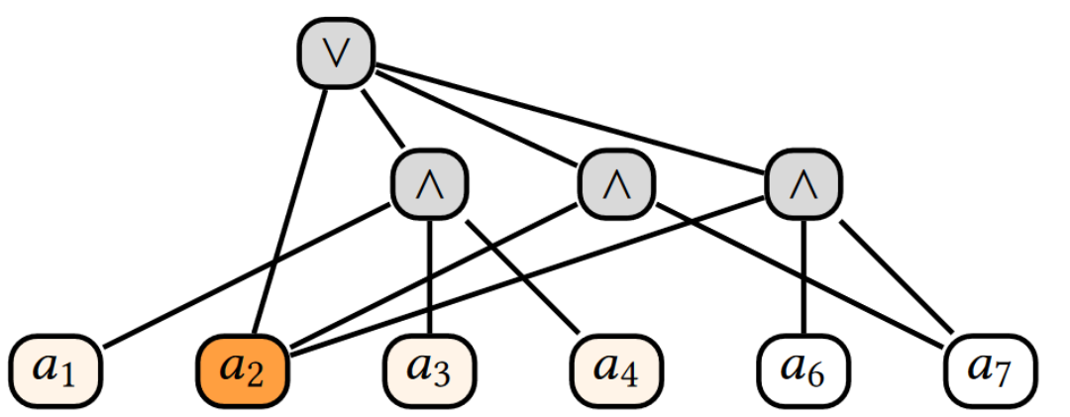
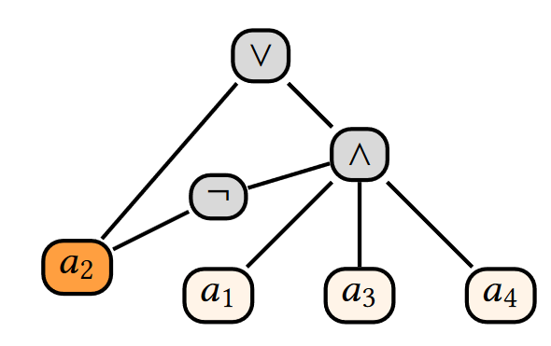
Knowledge Compilers
DNF
Deterministic and Decomposable
Knowledge compilation
Intractable in general, so no guarantees that the compilation succeeds
Yet there are excellent compilers out there (we used c2d)
Notes:
For instance, the DNF of Alices’ provenance circuit, which is displayed on the left, can be transformed to the equivalent circuit on the right.
Note, that the circuit on the right is deterministic and decomposable.
A circuit is deterministic if for all of its or-gates only a single input to the gates can be satisfied in all assignments.
Additionally, a circuit is decomposable if the inputs of all and-gates do not share variables.
Note that the circuit on the right maintains those two properties.

Slide 40
General Connection to Probabilistic Databases
Any Boolean query Q induces the problems Shapley(Q), PQE(Q)
PQE(Q) is Probabilistic Query Evaluation over tuple-independent databases
Proposition: For any Boolean query Q, if PQE(Q) is tractable then
so is Shapley (Q)
Intuitively: We again rewrite the Shapley formula, grouping the terms for all “Slices” of size k, and we need to count for how many such slices f “matters”
We can design a tuple-independent database so that this quantity is computable from the query probability using simple arithmetics

Slide 41
Making it work
We generate provenance C using ProvSQL and then wish to feed it to a knowledge compiler to transform it into a d-D circuit.
Technical problem: Knowledge Compilers such as c2d expect CNF as input.
Solution: Tseytin Transform applied to C yields a CNF 𝜑 with the following properties:
its variables are the original variables of 𝐶 plus some additional variables (denote by 𝑍);
(2) for a valuation 𝜈 ⊆ Vars(𝐶 ) that satisfies 𝐶, there exists exactly one valuation 𝜈 ′ ⊆ 𝑍 such that 𝜑 (𝜈 ∪ 𝜈 ′) = 1; and (3) for a valuation 𝜈 ⊆ Vars(𝐶 ) that does not satisfy 𝐶, there is no valuation 𝜈 ′ ⊆ 𝑍 such that 𝜑 (𝜈 ∪ 𝜈 ′) = 1
(4) The size of 𝜑 is linear in C

Slide 42
Inexact computation

Slide 43
Inexact ranking
For some provenance expressions, compilation may be too costly/ fail
Even if the compilation succeeded the exact computation may take considerable time to complete (see experiments)
The importance ranking, rather than the exact Shapley values, may suffice
Notes:
For many scenarios it is sufficient to obtain the importance ranking, rather than the exact Shapley values

Slide 44
CNF Proxy
Let $φ$ be a Boolean CNF, i.e., $\bigwedge_{i∈\left\{1,…,k\right\}}{ψ_{i}}$ where $ψ_{i}$ is a disjunction of literals (variables and negation of variables).
Let $ψ_{i}\left(ν\right)=1 if v satisfies ψ_{i}$ $and 0 otherwise$
Note that $φ\left(ν\right)=\prod_{i∈\left\{1,…,k\right\}}{ψ_{i}\left(ν\right)}$
Having a high Shapley value is correlated (in a complex manner) with
Appearing many times in the provenance
Having few "alternatives", that is, facts that could compensate for the absence of the given fact.
Notes:
The Shapley value of a fact is correlated with two properties of the provenance.
If a fact appears many times in the provenance – it is more likely to have a higher Shapley value
And if a record have few alternatives – then it is also likely to have a higher Shapley value

Slide 45
CNF Proxy
Given a CNF $φ\left(ν\right)=\prod_{i∈\left\{1,…,k\right\}}{ψ_{i}\left(ν\right)}$ we will define its proxy function
$$\tilde{φ}\left(ν\right)=\sum_{i∈\left\{1,…,k\right\}}{ψ_{i}\left(ν\right)}$$
Thanks to Shapley linearity property, computing Shapley values with respect to $\tilde{φ}$ can be performed in linear time
These may (and will!) be bad estimations for the real Shapley values for $φ$ but turns out that their order is often very much correlated with the order of the respective Shapley values
No guarantees on this neither, and in fact we have counterexamples where the order is also very bad
Notes:
Thanks to Shapley additivity property – computing Shapley values with respect to the proxy function can be performed in linear time
Note, that this function follows the previous intuition.
If a fact appears in many clauses of the provenance – it will tend to have a higher Shapley value, also according to the proxy function.
And if a fact has few alternatives in its clause – then it will also tend to have a higher Shapley value.
Note that the proxy function is a different function than the original provenance, and as a result the Shapley values of it will be different than the original query values – but we saw that in many cases the ranking of facts influence based on the proxy function matches the correct ranking.

Slide 46
Experiments

Slide 47
Setup
Implementation uses PostgreSQL 11.10+ ProvSQL [Senellart et. Al, VLDB ‘18]+ c2d (http://reasoning.cs.ucla.edu/c2d/) + new Python code (GitHub - navefr/ShapleyForDbFacts)
40 queries over the IMDB and TPC-H databases
Obtained 95,803 output tuples along with their provenance expressions
Experiments run on Linux Debian 14.04 machine with 1TB of RAM and an Intel Xeon Gold 6252 CPU @ 2.10GHz processor
Notes:
We used 40 different queries over IMDB and TPC-H databases.
From these queries we obtained 95 thousand output tuples along with their provenance (which was obtained using ProvSQL).

Slide 48
Success rate for exact computation
IMDB
99.96% of the output tuples
TPC-H
84.43% of the output tuples
Failures in KC due to insufficient memory
Notes:
For the exact computation.
In IMDB – for 99.96% of the output tuples were able to compile the provenance to a deterministic and decomposable circuit.
In TPC-H – we were able to compile 84.43% of the provenances.

Slide 49
Representative statistics (exact computation)
Notes:
Here we can see few representative queries along with their execution time (which include provenance generation).
We can also see how many output tuples each query produced.
And the success rate indicate the percentage of output tuple provenances that we were able to compile.
Next, for the successful cases, we can see distribution over the times of knowledge compilation and calculation of Shapley values over the compiled circuits.

Slide 50
Cases that do not compile are also hard for smaller DBs

Slide 51
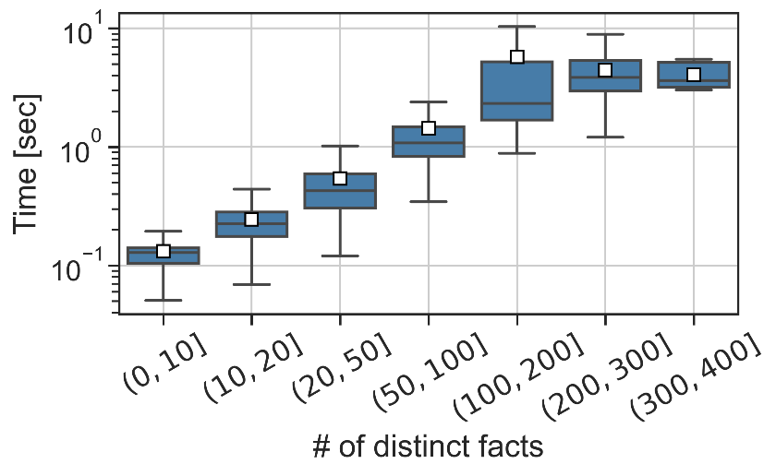
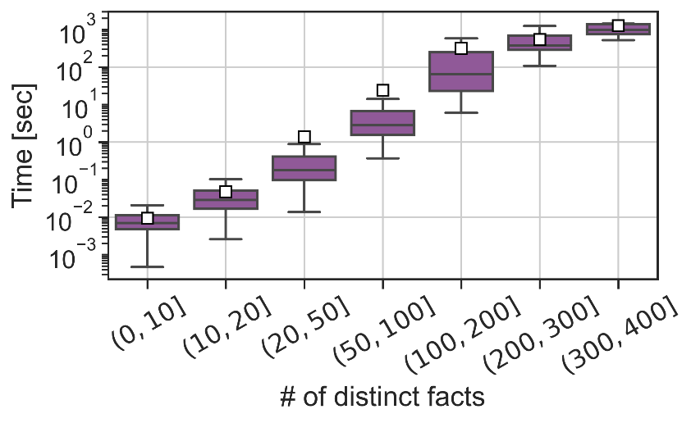
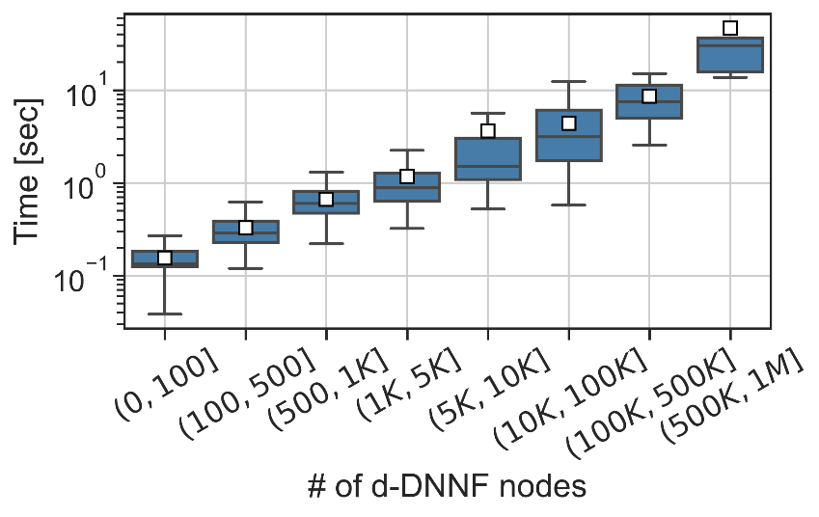
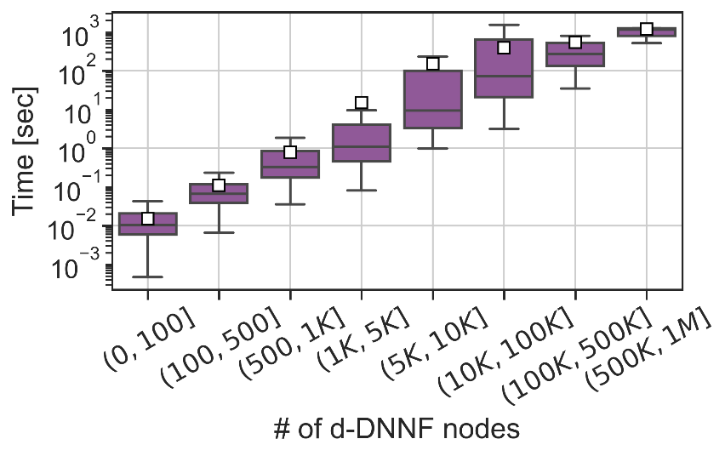
Exact computation running times
Knowledge compilation
Shapley computation
Notes:
Here we can see the running time of both knowledge compiliation and Shapley computation at different sizes of the provenances.

Slide 52
Inexact computation
Algorithms
Monte Carlo (*)
Kernel SHAP (*)
CNF Proxy
(*) – Performance depends on #samples
Measurements
L0, L1
Precision @K, nDCG (Normalized Discounted Cumulative Gain)
Notes:
For the inexact.

Slide 53
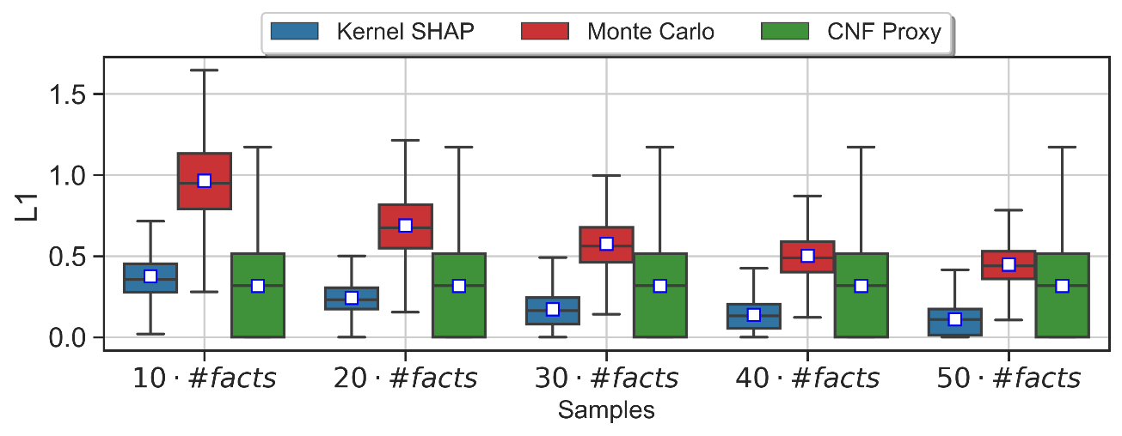
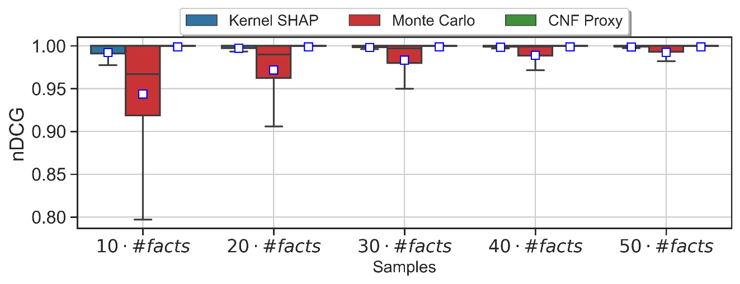
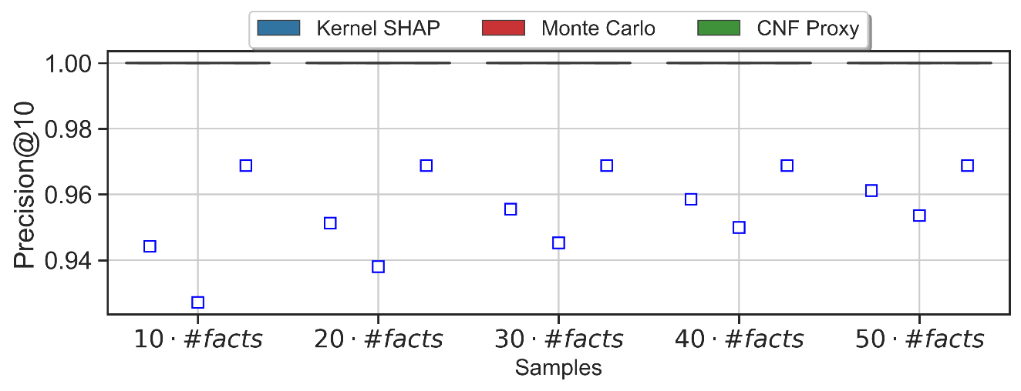
Inexact computation (per sampling budget)

Slide 54
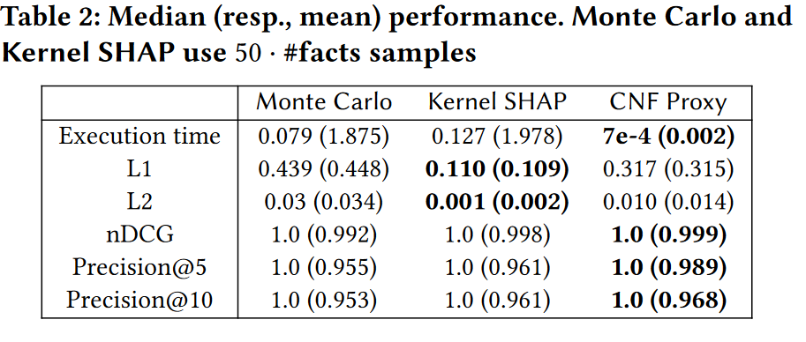
Inexact computation
CNF Proxy is preferable for ranking contributions but will not fit if actual values are needed

Slide 55
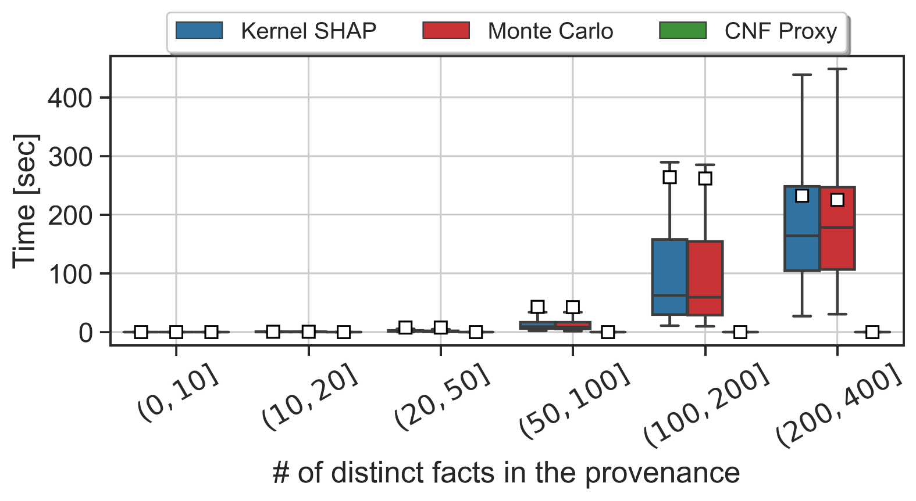
Inexact computation running time
CNF Proxy is substantially more efficient compared to Monte Carlo & Kernel SHAP

Slide 56
Inexact computation running time
CNF Proxy is substantially more efficient compared to Monte Carlo & Kernel SHAP

Slide 57
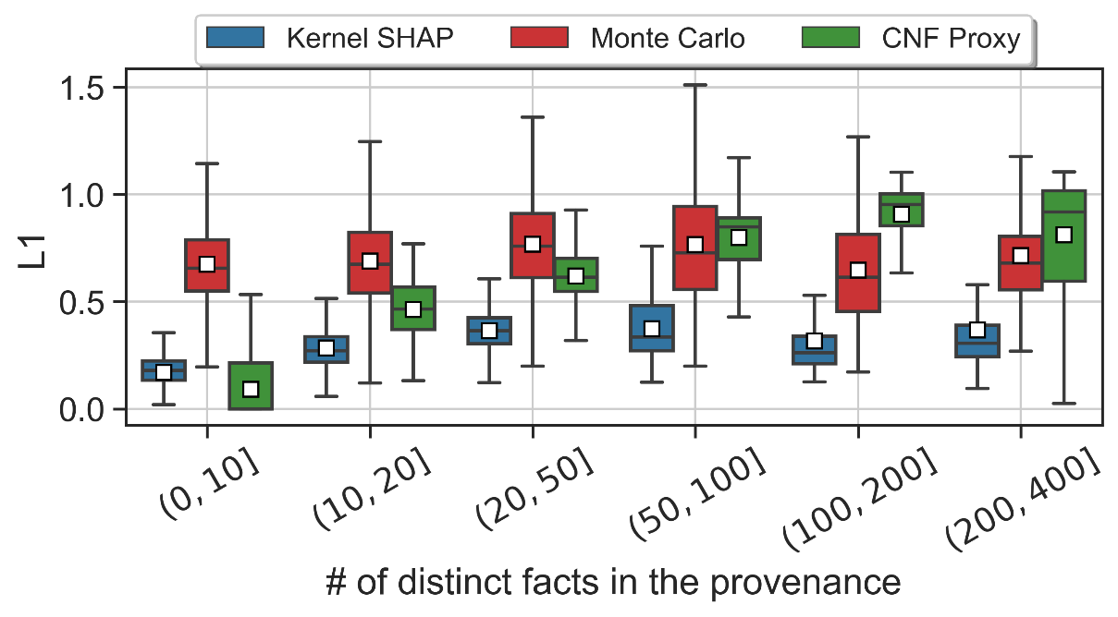
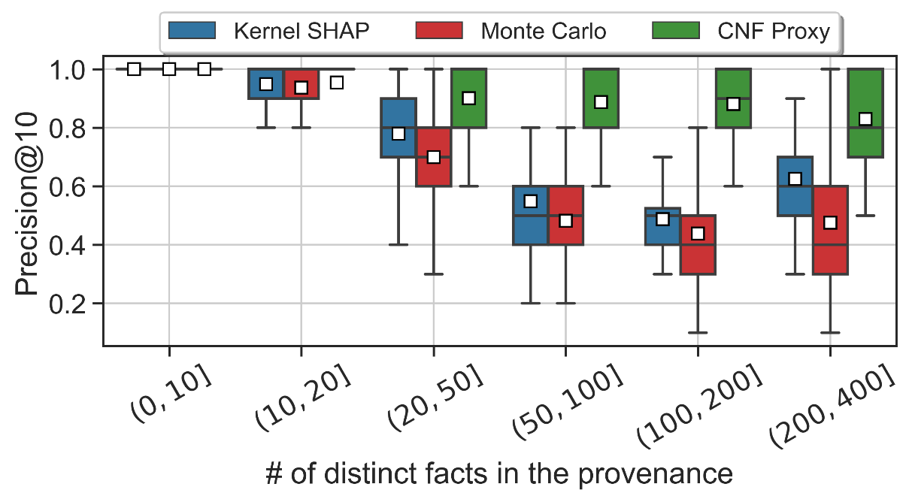
Inexact computation (per provenance size)

Slide 58
Inexact computation (per provenance size)
CNF Proxy is preferable for ranking contributions but will not fit if actual values are needed

Slide 59
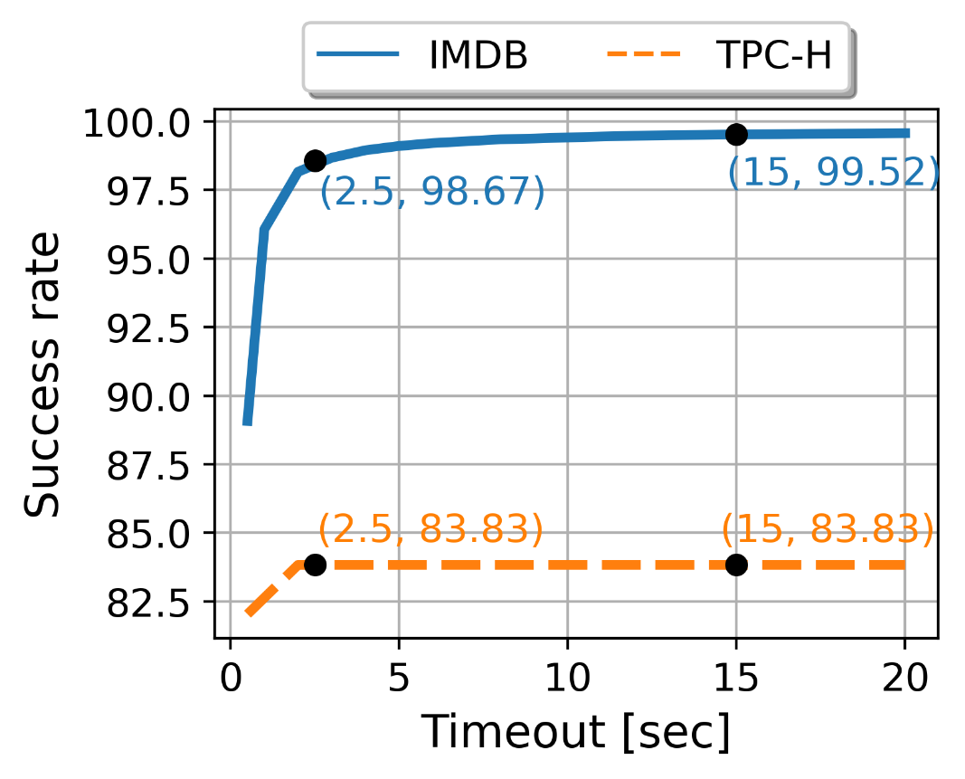
Hybrid computation
Start by running the exact computation
If the exact computation completes successfully in under $t$ seconds, return its result
Otherwise, terminate the exact computation and execute CNF Proxy

Slide 60
Hybrid computation
Start by running the exact computation
If the exact computation completes successfully in under $t$ seconds, return its result
Otherwise, terminate the exact computation and execute CNF Proxy
For most output tuples (98.67% for IMDB and 83.83% for TPC-H) exact computation of Shapley values terminates within 2.5 seconds.

Slide 61
ShapGraph [Demo @ SIGMOD ‘22]
Shapley values quantify individual contribution of input tuples
Provenance Circuits detail the interactions between these tuples
Combining the two views may be useful

Slide 62
ShapGraph [Demo @ SIGMOD ‘22]

Slide 64
Future Work
Provenance generation remains a bottleneck
Can we generate (a reasonable) ranking of facts without provenance?
Lineage may be OK (a set of facts with non-zero Shapley)
One direction: learning from query logs

Slide 65
The DBShap dataset
https://www.cs.tau.ac.il/~danielde/dbshap_page/dbshap.html
Currently includes 197 unique queries (over the IMDB database), with a total of 970K output tuples, and 17M non-zero contributing facts. For each pair of (query,output tuple) the dataset includes the exact Shapley value
Initial models that learn from past queries achieve encouraging results in terms of ranking the facts in a given lineage

Slide 66
DB-based explanations can help!
We have focused on Shapley computation for query answers
Shapley-based explanations for additional components in the Data Science pipeline
Deutch, Frost, Gilad and Sheffer, Explanations for Data Repair Through Shapley Values. CIKM 2021
Deutch, Gilad, Milo and Somech, ExplainED: explanations for EDA Notebooks, Demo @ VLDB 2020
Counterfactual explanations for ML models Deutch and Frost, Constraints-Based Explanations of Classifications, ICDE 2019 Schleich, Geng, Zhang and Suciu, GeCo: Quality Counterfactual Explanations in Real Time, VLDB 2021
Shrotri et. Al, Constraint-Driven Explanations for Black Box ML Models, AAAI 2022
Meyuhas, Ben-Arie, Horesh and Deutch, CFDB: Machine Learning Model Analysis via Databases of CounterFactuals, Demo @SIGMOD 2022

Slide 67
T-REX: Table Repair Explanations

Slide 68
CEC: Constraint-based Explanations for Predictions

Slide 69
Conclusion
Explanations are needed for different parts of the Data Science Cycle
Why-provenance captures the essence of computation for queries, but it may be hard to see the forest for the trees
Meanwhile, feature attribution is getting traction in ML
We propose ShapGraph: Provenance Circuits summarizing the computation + Shapley values for individual nodes
Why-provenance is also costly
Can we get reasonable attribution without it?
Shapley-based explanations for other Data Science tasks
Another avenue of research: Incorporating DB Constraints in Counterfactual Explanations

